Slide 1

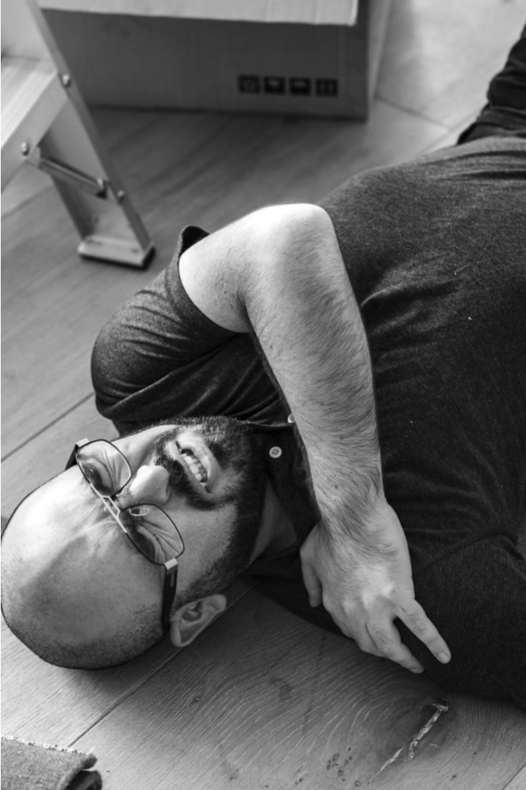

Live Fall Detection
Leveraging computer vision to detect and alert when a person falls, providing crucial safety and peace of mind.

Slide 2
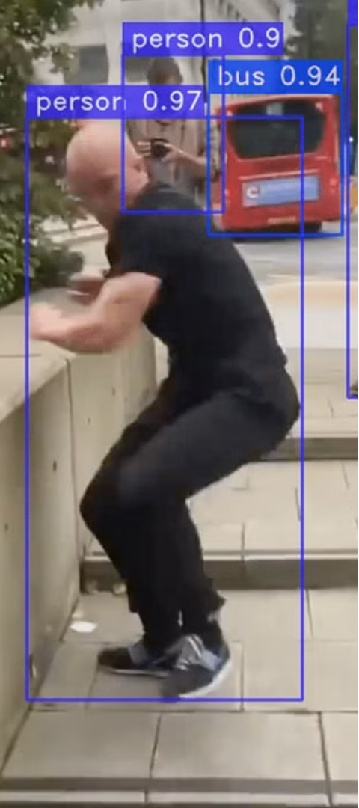
YOLO Version 8 Overview
1
Improved Accuracy
2
Low Latency
Powerful deep learning model for real-time object detection
Optimized for fast processing on edge devices
3
Flexible Implementation
Compatible with a variety of hardware platforms

Slide 3
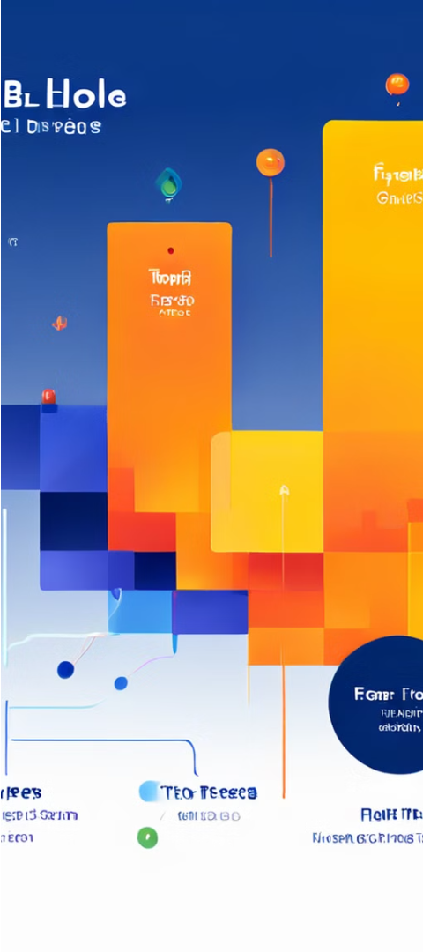
Fall Detection Algorithm
1
Person Detection
Identify individuals in the camera feed
2
Posture Analysis
Analyze body position and movement patterns
3
Fall Classification
Determine if a fall has occurred using YOLO 8

Slide 4
Arduino Hardware Setup
Arduino Uno
Camera Module
Buzzer
Compact and versatile microcontroller board
Enables computer vision capabilities
Provides audible alerts for fall detection

Slide 5



Arduino Buzzer Alert
Audible Alert
Fall Detected
Notification
Arduino buzzer sounds to notify caretakers
YOLO 8 model identifies the fall event
Sends alert to caretakers via Arduino

Slide 6

Email Notification Setup
Automated Alerts
Contact Information
Reliable Monitoring
Instantly notify designated caretakers via email
Ensures caretakers are promptly informed of any falls
Includes details like location and emergency contacts

Slide 7




Conclusion and Future
Robust Fall Detection
Effective YOLO 8 model and hardware setup
Integrated Alerts
Arduino buzzer and email notifications
Future Improvements
Explore AI-powered activity tracking and predictive analytics

